Slide 1
Capstone Invent
Motivation
Capstone Ideas
Short Walk to the Edge of Knowledge
Evolution vs Big Leaps
Context powers Innovation
Diverse network – be a node!
Mass production
Tools build tools (and jigs) to invent
The best designers…

Slide 2
Why are you here?
What motivated you to become a chemical/environmental/biological/civil/ mechanical engineer?
How important is passion or a connection with meaning in your choice of a career?
What will motivate you to get up and go to work every weekday morning?
What kind of capstone design project do you want to do?

Slide 3
Previous Capstone Ideas
Historically the ideas from Capstone design projects have moved into the AguaClara Design Engine or became research projects
Flow controller – dose controller
Vertical flow flocculator design
Economic analysis of flocculator channel width
Arsenic removal
Small (1 L/s) and large (1000 L/s) plants
Chlorinators
Enclosed StaRS Filters
New inlet system for StaRS Filters

Slide 4
3 New initiatives
Create a plan to provide safe water to small communities in
Puerto Rico (a general island wide diagnosis)
Bolivia – several towns on an island
Colombia – rural town
Aide_Design
Non-linear CDC for simplified chemical dosing for small flows. Variable dosing valve to replace slider on CDC to simplify small systems.

Slide 5
AIDE Design Modules
Entrance Tank
PVC design for flows from 1-5 L/s
civil works design for flows from 6-60 L/s
Flocculator
10-100 L/s (vertical flow in channels)
1-5 L/s (pipe flocculators): cost comparison of H=D (baffles separated by distance S) and S=D (baffles separated by distance H) designs
Sedimentation tank (civil work)
channel design from flocculator to filters (flows from 6-60 L/s)
remainder of sedimentation tank (6 m long floc blanket zone)
Sedimentation tank (PVC pipe) for about 1 L/s
OStaRS (open stacked rapid sand filter) (8 to about 25 L/s per filter)
Entrance/Exit tanks including flow control weir
Filter box with manifolds, slotted pipes, and winged pipes
EStaRS (enclosed stacked rapid sand filter) PVC pipe
12 inch diameter filter
24 inch diameter filter
36 inch diameter filter

Slide 6
AIDE_Design
Identify all of the constraints that you will use for the design.
Identify a methodical step-by-step path to design the unit.
Create algorithms to turn the constraints into design specifications (dimensions).

Slide 7
The opportunities for learning new things are incredible
It is a very short walk to the edge of knowledge
There is always potential for evolution in theory, design, and practice
Evolution doesn’t necessarily take you to the best solution!

Slide 8
Major improvements to water treatment technologies are still possible!
Innovation can be a big break from evolution (or from state-of-the-art)
Dose controller
Stacked rapid sand filters
Dramatic changes in design targets (W_{Sed}, V_{Sedup}, V_{c}, G_{Floc}, depth of floc blanket)
Try extreme conditions and learn what fails or perhaps find unexpected success!
Notes:
When all else fails, do not hesitate to apply extreme conditions; it may be a mistake to ease into the problem. Many years ago it was believed that molds grew best when cultured as a floating pad of mycelium in a pool of nutrient solution. It was common wisdom that poking at the pad or disturbing it too much interfered with good growth. Then in 1933 Perquin and Kluyver showed that shake flask culture - continuous vigorous agitation - was a good way to grow molds. Thus they opened up the whole era of deep-tank submerged cultivation which has become the foundation of modern fermentation technology.
Robert K. Finn “The Fun and Challenge of Applied Research”
http://onlinelibrary.wiley.com/doi/10.1002/btpr.5420020102/epdf

Slide 9
Invention are born in a context
I never perfected an invention that I did not think about in terms of the service it might give others...I find out what the world needs, then I proceed to invent it. -Thomas Edison
Learn the history and current state of the technology
Then question it all and proceed to Invent

Slide 10
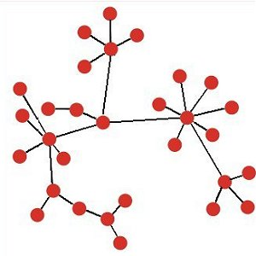
Innovators Build Bridges between Networks
Make connections with completely different networks
Get outside your social class, your country, your business, your university
Get diverse experiences, take things apart, experiment, fail, observe…
Flocculate Ideas!
Be a node!

Slide 11
Capstone Design
Invention
I am not asking you to design something that 100s of engineers have designed previously
I am asking you to invent something new, something better than what currently exists

Slide 12
What kind of an Engineer are you?
Good at using Google?
Satisfied with making one design at a time?
Able to think about the context and create new solutions and new algorithms?
Able to generalize the problem and the solution
Intrigued by the possibility of creating new systems (and jigs)?
Did you need Cornell for this?

Slide 13
Are you Ready for the Transition to Mass Production?
Historically Environmental Engineers have resisted standardization
Each water treatment plant was custom designed
Perhaps we saw this as job security
We liked to think that each problem we were solving was unique

Slide 14
100 years before AguaClara…
Early on, manufacturers did not standardize car models - each car was a custom production
Multiple early car manufacturers began standardizing and mass producing identical cars
Ford incorporated the Ford Motor Company in 1903, proclaiming, "I will build a car for the great multitude."

Slide 15
AguaClara Introduces Mass Production of Designs
Ford in 1903, "I will build a car for the great multitude."
AguaClara in 2005… We will design a water treatment plant for Ojojona
AguaClara in 2006… We will build a jig that can design customized water treatment plants for the great multitude
AguaClara in 2017… time for a new jig!

Slide 16
Jigs: Can you connect this to AguaClara?
A jig is any of a large class of tools that help to control the location or motion (or both) of a tool.
The primary purpose for a jig is for repeatability and exact duplication of a part for reproduction.
In the advent of automation and CNC machines, jigs are not required because the tool path is digitally programmed and stored in memory.
The jig is often much more complicated than the piece being built!
http://en.wikipedia.org/wiki/Jig_%28tool%29

Slide 17
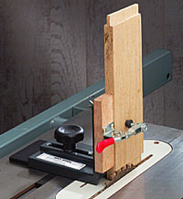
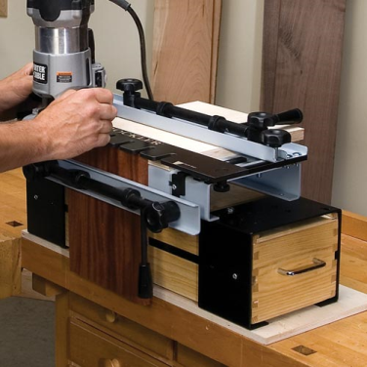
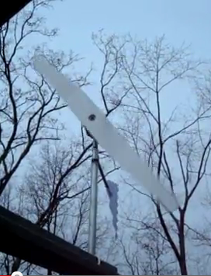
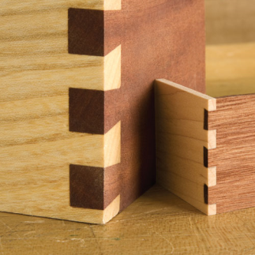
Jigs…
Provide control and repeatability for production work
I’ve been making jigs since the late 1970s
Wooden stars, tops, and windmill blades

Slide 18
Jigs: Provide control and repeatability for production work
Taking the concept of a jig to the next level
ProCoDA – a jig that can be easily configured to automate many different kinds of experiments
aide_design – a jig that can easily be configured to produce designs of anything!

Slide 19
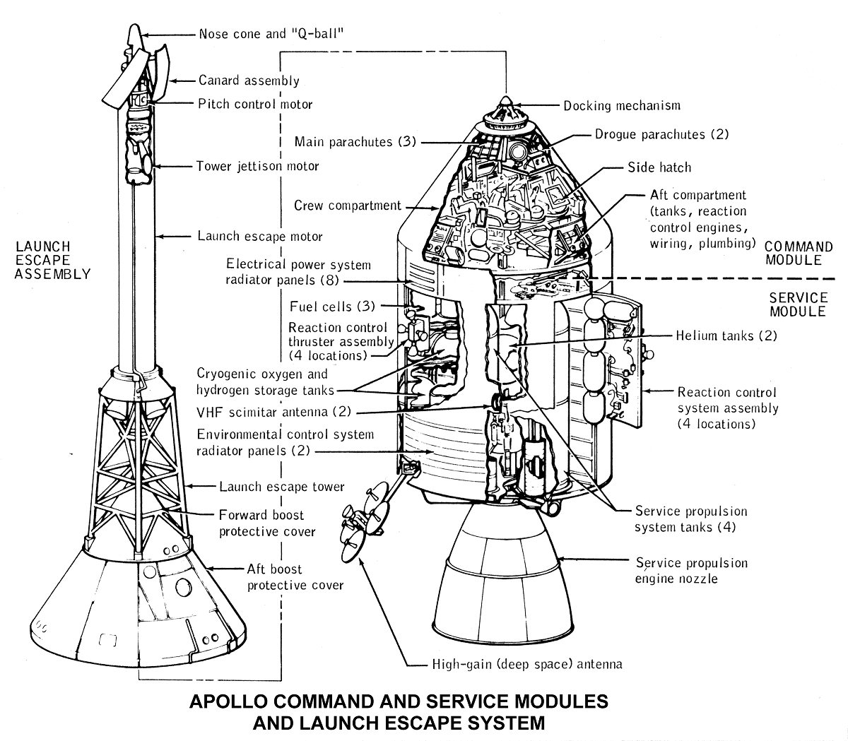
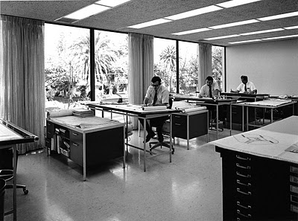
Evolution of how engineers created drawings
Room full of draftsmen
Computer drawing 2-D then 3-D
Parametric drawing (given H, W, L, T it can draw a tank)
Engineered Parametric Drawing (given flow rate it can draw a municipal water treatment plant)
Aide_design!

Slide 20
How do you Invent?
Question EVERYTHING including the Question
Ask WHY?
Sketch new ideas – create a ranking
Remember what you know
Watch out for your assumptions
Why not make deep flocculators more efficient?
Why baffles?
Mass is conserved
Breaking flocs is bad (maybe)
Notes:
Assemble a team!
Humility to acknowledge what you don’t know
Push the edge
Immerse yourself in the context of the problem
Learn the state of the art theories, but don’t assume they are all correct
Identify the constraints that are preventing advance in an attribute that is important, then break the rules
Beware of places where authors say “it is well known that….” or “standard practice for many years has been…”

Slide 21
What is Intelligent Design?
Identify the Objectives
Identifying the correct Constraints (sketch them) and create dimensionless parameters
Creating the best Algorithms based on Physics, Constructability, Maintenance, Economics
Converting constraints into Dimensions using algorithms
Convert Dimensions into Layouts

Slide 22
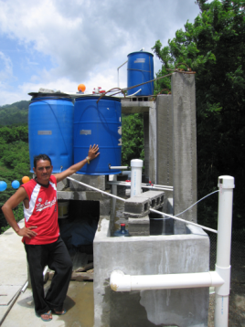
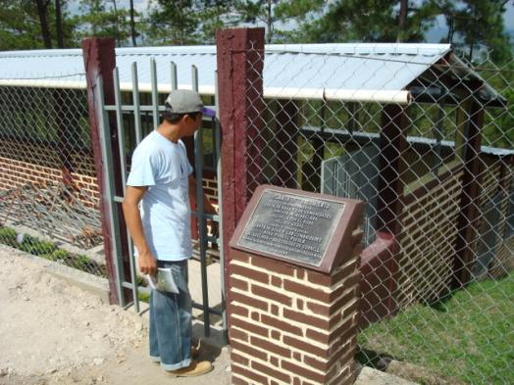
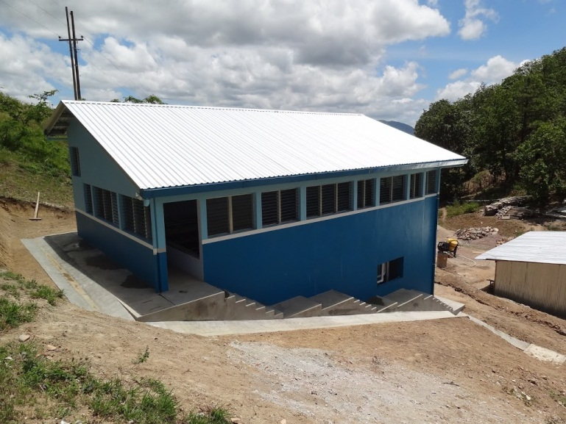
Beauty?
Do aesthetics matter?
Beauty in equations, algorithms, facilities, and in a healthy community
La 34
Cuatro Comunidades
San Matias

Slide 23
Innovation
Ask what if we…
Requires a willingness to make mistakes
Play with geometry to generate new insights
Try to unearth and revisit each design assumption
Remember physics and social context: know your constraints

Slide 24

Frugal and Generous
If we are going to make the world a better place we will need to be frugal and generous
Frugal: careful about spending money or using things when you do not need to : using money or supplies in a very careful way
Generous: freely giving or sharing money and other valuable things
: providing more than the amount that is needed or normal : abundant or ample
: showing kindness and concern for others

Slide 25
The best designers…
Explore how changes in design constraints affect the geometry (rotate, invert, make it square, make it round…)
Create multiple graphs or sketches showing relationships
Text is NOT how you invent new ideas!
Don’t assume a constraint is set in stone
Exploring options quickly – fail fast!

Slide 26
…create with geometry
Play with geometry (stacked filters)
As scales change the optimal geometry can change radically (flocculators that switch from vertical to horizontal to pipes )
Ask what happens if we
Turn this 90 degrees
Rotate this so it lines up with the plate settlers
Try a different layout
Select the simple solutions
Notes:
(levers or pulleys)

Slide 27
…use tools
Use the aide_design code as needed. No need to recreate the code.
Investigate what others have done to solve similar problems

Slide 28
…write in Jupyter?
Craft a report that can be read from top to bottom
Include sketches, equations, comparisons
Spell check
Make sure someone from your team proofreads the entire document before submission
Explain your solution steps from objectives to constraints to algorithms to dimensions to layout

